Slide 1
Development of a Digital Farm Management Portal for implementing Biosecurity measures in Pig and Poultry Farms
CSE7302- University Project
Review-2
Batch Number: CSE_100
Under the Supervision of,
Ms. Poonam
Professor / Associate Professor / Assistant Professor
School of Computer Science and Engineering
Presidency University
Roll Number | Student Name
20221CSE0454 | Yanamala Jaswanth Reddy
20221CSE0506 | Amaregouda
20221CSE0451 | Purohith Satyanarayana
Name of the Program: CSE
Name of the HoD: Dr. Blessed Prince
Name of the Program Project Coordinator: Mr. Muthuraju V
Name of the School Project Coordinators: Dr. Sampath A K , Dr. Geetha A

Slide 2
Content
Problem Statement
Abstract
Literature Survey
Objectives
Existing Methods and Drawbacks
Proposed Method & Feasibility Study
Architecture Diagram
Modules
Hardware and Software Details
Timeline (Gantt Chart)

Slide 3
Analysis of Problem Statement
Pig and poultry farms are highly vulnerable to infectious disease outbreaks due to inadequate biosecurity practices.
Many farms continue to rely on manual record-keeping and unstructured monitoring of livestock health, hygiene, and sanitation activities.
The absence of systematic documentation makes it difficult to detect biosecurity breaches at an early stage.
Small and marginal farmers often lack access to simple digital tools that support biosecurity compliance and disease prevention.
Existing digital solutions are either too complex, costly, or not tailored to farm-level biosecurity implementation.
There is a need for a user-friendly digital platform that enables pig and poultry farmers to implement, monitor, and sustain biosecurity measures effectively

Slide 4
Abstract
The Problem: Small-scale Pig and Poultry farms in India are highly vulnerable to disease outbreaks due to manual record-keeping and lack of biosecurity awareness. Expensive IoT solutions are not feasible for these farmers.
The Solution: We are developing a Biosecurity Management Portal using Node.js, Express, and MySQL. It replaces paper registers with a digital system that tracks livestock health, inventory, and hygiene compliance.
Key Approach: The system provides dual-species management (Pig & Poultry) and uses rule-based logic to alert farmers about missed vaccinations or biosecurity lapses.
Outcome: To empower rural farmers with a simple, low-cost digital tool that ensures data-driven decision-making.

Slide 5
Literature Survey
Source & Year | Paper Title | Key Inference | Research Gap / Limitation
[IEEE] Padua, J.N., et al. (2024) | IoT-Based Smart Poultry Farming: Enhancing Security and Monitoring for High-Quality Production | Proposed a system to control exhaust fans and alert owners about Ammonia levels (>7ppm) using networked sensors. | Hardware Cost: Relies on expensive sensors for ammonia/temp, which is not affordable for small Indian farmers.
[IEEE] Shaik, M., et al. (2024) | Eco-efficient Poultry Farms: Leveraging IoT for Sustainable Production | Integrated RFID tags for tracking individual bird health and smart feeders for automated nutrition. | Scalability: Tagging individual birds with RFID is financially impossible for farms with thousands of birds.
[Springer] Singh, V., et al. (2024) | Awareness and adoption of farm biosecurity practices in commercial dairy, pig and poultry farms | Surveyed farms to find that "Knowledge Level" is the biggest factor in biosecurity adoption (not just money). | No Tool Proposed: Identifies the lack of knowledge but offers no digital tool to educate or guide the farmer.

Slide 6
[IEEE] Bagyam, L.N., et al. (2024) | Implementation of Temperature and Moisture Controller in Poultry Using IoT | Designed a microcontroller-based system to automatically mist/cool the shed when temperature exceeds 35°C. | Automation Focused: Focuses purely on climate automation, ignoring disease logging or mortality tracking.
[Springer] Bernaerdt, E., et al. (2023) | Optimizing internal biosecurity on pig farms by assessing movements of farm staff | Tracked staff movements to prove that "Dirty Zone" violations are the main cause of disease spread in piggeries. | Complex Tracking: Requires wearable trackers for staff; does not provide a simple mobile logbook solution.
[IEEE] Jayapoorani, S. (2024) | Smart Farming: IoT-Based Monitoring and Automated Ventilation in Poultry | Utilized Wi-Fi microcontrollers to enable remote monitoring of farm ventilation systems via a cloud dashboard. | Connectivity: Relies on continuous high-speed Wi-Fi, which is often unreliable in remote Indian villages.

Slide 7
[Springer] Galipo, E., et al. (2023) | Prioritization of pig farm biosecurity for control of Salmonella and Hepatitis E virus | Ranked "Cleaning and Disinfection" as the #1 most effective measure against Salmonella in pig farms. | Theoretical: Provides a ranking of rules but no software interface to ensure farmers actually follow them.
[IEEE] Tong, Q., et al. (2024) | Edge AI-Enabled Chicken Health Detection Based on Enhanced FCOS-Lite | Used Edge AI cameras to detect sick chickens in real-time by analyzing their movement patterns. | High Compute: Edge AI requires expensive processors (GPUs) on-site, making it inaccessible for low-budget farms.
[Springer] More, S.J., et al. (2023) | Temporal trends in biosecurity in Irish pig herds using a standardized scoring system | Analyzed biosecurity scores over 5 years, finding that "Internal Biosecurity" (staff hygiene) is often neglected. | Manual Scoring: Relied on manual audits by experts, whereas our portal allows farmers to self-assess daily.
[IEEE] Susanto, F., et al. (2023) | Design of a Temperature and Humidity Monitoring System in Broiler Farms Using Thingspeak | Created a cloud-based logger for broiler farm data using the ThingSpeak IoT platform. | Single Species: Designed exclusively for Broilers; cannot be used by farmers who raise both Pigs and Poultry.

Slide 8
Objectives
Primary Objective :
To design and develop a Digital Farm Management Portal that supports the implementation and monitoring of biosecurity measures in pig and poultry farms.
Secondary Objectives
To maintain structured digital records of pig and poultry batches for traceability
To document and monitor health, vaccination, and sanitation activities
To support biosecurity compliance through systematic record-keeping
To reduce dependency on manual farm logs and paperwork
To improve disease prevention and farm-level biosecurity awareness

Slide 9
Existing Methods and Drawbacks
Method 1: Manual Record Keeping (Logbooks)
Current Practice: Farmers write daily mortality counts, feed usage, and vaccination dates in physical paper registers.
Drawbacks:
Data Vulnerability: Registers are easily lost, damaged by farm conditions (water/dust), or eaten by pests.
Zero Analytics: You cannot search history or see trends. A farmer cannot easily answer, "Did mortality spike this time last year?"
Human Error: Calculation mistakes in feed ratios or mortality percentages are common.

Slide 10
2. Legacy Desktop Software / Spreadsheets:
Method: Using Excel sheets or offline software installed on a single farmhouse computer.
Drawback:
No Mobility: Data is trapped on one device; farmers cannot enter data while inside the shed.
Passive Data: It only stores numbers; it does not trigger active alerts (e.g., "High Risk") based on the data.
No Vet Access: A remote veterinarian cannot view the farm's status in real-time.
3. Generic Farm Apps:
Method: Using general mobile apps designed for Agriculture (Crops) or Dairy.
Drawback: They lack the specific Biosecurity & Hygiene inputs required for Pig and Poultry farms (e.g., "Clean/Dirty Zone" tracking).

Slide 11
Proposed Method & Feasibility Study
Proposed Method
Web-based biosecurity-focused farm management portal
Modules for livestock batches, biosecurity checklists, health records, and incidents
Biosecurity risk scoring and compliance status generation
Role-based controlled access
Feasibility
Technical: Implemented using standard web technologies
Economic: Low-cost, no specialized hardware required
Operational: Simple UI suitable for rural environments
Scalability: Can be extended for regional deployment

Slide 12
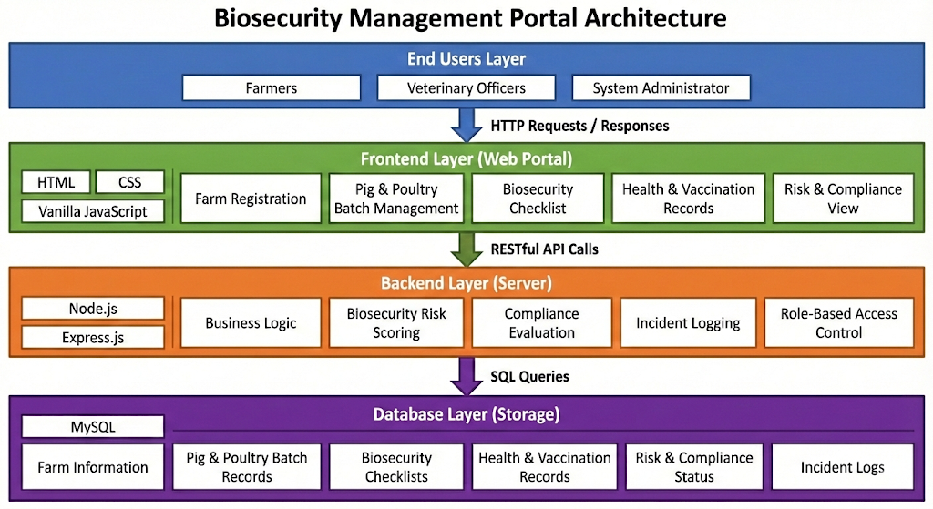
Architecture Diagram

Slide 13
1.End User Layer:
The system caters to three distinct roles: Farmers (for data entry), Veterinary Officers (for monitoring), and System Administrators (for user management).
Users access the portal via standard HTTP requests from any web-enabled device.
2. Frontend Layer (Presentation):
Built using HTML, CSS, and JavaScript to ensure a lightweight and fast-loading interface for rural connections.
Key Interface Modules:
Farm Registration: Onboarding new pig/poultry units.
Batch Management: Tracking specific livestock groups.
Biosecurity Checklist: Daily forms for hygiene compliance.

Slide 14
3. Backend Layer (Business Logic):
Powered by Node.js and Express.js, this layer handles the core processing.
Risk Scoring Engine: Processes user inputs to calculate real-time Biosecurity Risk Scores.
Compliance Evaluation: Automatically checks if vaccination schedules and hygiene protocols are being met.
4. Database Layer (Storage):
We utilize MySQL for structured, relational data storage.
It securely stores critical records including Farm Information, Health & Vaccination Logs, and Incident Reports.
The backend communicates with the database using efficient SQL Queries.

Slide 15
Modules
Farm Registration Module: Onboards new farms into the system and configures specific zones like poultry sheds or pig units for organized management.
Pig & Poultry Batch Management Module: Tracks the complete lifecycle of specific livestock groups, monitoring age, breed, and daily headcount updates.
Biosecurity Checklist Module: Provides daily digital forms for farmers to verify adherence to critical hygiene protocols, such as footbath usage and visitor sanitation.
Health & Vaccination Module: Maintains a digital logbook for scheduling upcoming vaccines and recording daily sickness or mortality events.
Biosecurity Risk Scoring Module: Processes farm data through a backend logic engine to calculate a real-time "Risk Score" (Low, Medium, or High).
Incident Logging Module: Captures critical events such as biosecurity breaches, sudden mortality spikes, or disease outbreaks for historical auditing.
Compliance Status Module: Visualizes overall adherence to safety standards, instantly flagging farms that are failing to meet mandatory biosecurity protocols.

Slide 16
Problem Statement Number : SIH25006
Organization:
Category (Hardware / Software / Both) : Software
Problem Description:
There is an urgent need for a user-friendly, digital platform that empowers farmers to implement
monitor, and sustain robust biosecurity practices on their farms.
Customizable risk assessment tools based on local epidemiological conditions.
• Interactive training modules and best practice guidelines tailored for pig and poultry production systems.
• Compliance tracking features aligned with regulatory frameworks to help farmers work toward disease-free compartment recognition.
• Real-time alerts and monitoring dashboards for disease outbreaks and biosecurity breaches.
• Multilingual and mobile-first design to ensure accessibility in remote and rural areas.

Slide 17
Software and Hardware Requirements
Software Requirements
Operating System: Windows / Linux
Frontend Technologies: HTML, CSS, Vanilla JavaScript
Backend Technology: Node.js with Express.js
Database: MySQL
Development Tool: Visual Studio Code
Version Control: Git and GitHub
Web Browser: Google Chrome / Mozilla Firefox
Hardware Requirements
Processor: Intel Core i3 or higher
RAM: Minimum 8 GB
Storage: Minimum 256 GB HDD/SSD
Internet Connectivity: Required for development and updates

Slide 18
Timeline of the Project(Gantt Chart)
Phase wise Reviews
Phase | Start Date | End Date
Review-1 | 10-01-2026 | 16-01-2026
Review-2 | 31-01-2026 | 06-02-2026
Review-3 | 28-02-2026 | 06-03-2026
Review-4 | 03-04-2026 | 09-04-2026
Final Viva | 20-04-2026 | 26-04-2026

Slide 19
Analysis of Problem Statement
Technology Stack Components:
Frontend
HTML – Structure of the web pages
CSS – Styling and layout for user-friendly interfaces
Vanilla JavaScript – Client-side validation and interaction
Backend
Node.js – Server-side logic and request handling
Express.js – RESTful API development for farm data processing
Database
MySQL – Relational database for storing livestock, health, and biosecurity records

Slide 20
References(IEEE Format)
[1] Food and Agriculture Organization of the United Nations (FAO), Biosecurity for Highly Pathogenic Avian Influenza, FAO Animal Production and Health Manual, Rome, Italy, 2020.
[2] World Organisation for Animal Health (WOAH), Terrestrial Animal Health Code: Biosecurity Procedures in Poultry and Pig Production, Paris, France, 2022.
[3] J. Rushton, “The economics of animal health and biosecurity,” Revue Scientifique et Technique (OIE), vol. 36, no. 2, pp. 385–398, 2019.
[4] S. Patel and M. Verma, “Web-based farm management systems for disease prevention in poultry farms,” Journal of Animal Health and Production, vol. 9, no. 3, pp. 112–118, 2020.
[5] Ministry of Fisheries, Animal Husbandry and Dairying, Government of India, National Action Plan for Prevention, Control and Containment of Avian Influenza, New Delhi, India, 2021.

Slide 21
Github Link
The Github link provided should have public access permission.
Github Link

Slide 22


